Slide 1



The Strategy Studio
A high impact collaborative session to create QA Strategies
Company confidential

Slide 2
“The Strategy Studio” Agenda
1
Onboarding and Reception
10:00 – 10:30
2
Opening and Introductions
10:30 – 10:45
3
Testing themes: Test Plan, Process, Data, Environments
10:45 – 11:45
☕
Tea break
11:45 – 12:00
4
Themes (continued): Test Capability, Automation, NFT
12:00 – 13:00
🥗
Lunch
13:00 – 14:00
5
Solution demonstrations: Functional, Integration, Data, Documents, E2E reconciliation
14:00 – 15:30
☕
Tea break
15:30– 16:00
6
Recap, Actions, Next Steps, Time lines, Feedback
16:00 – 17:00

Slide 3
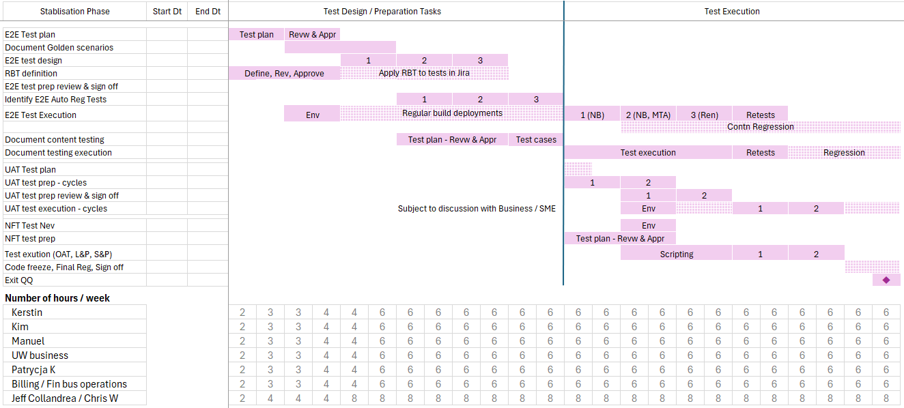
Test plan: phases, milestones and deliverables

Slide 4
Test plan: dependencies summary
Individual tickets added in Jira
GPAS test environment across test phases (In Sprint, E2E, UAT, NFT)s
Integration test environments
Availability, support
Defect fixes (POC for triage calls)
ST / In Sprint test completion
  Agresso
  MDA
  MDM
  CRM
  Precisely
  UWWB
  Insight
  HX
Integration test teams support
Test design
Test execution
Test data
Of test steps within their systems.
E2E and UAT
Process managed by GPAS test manager
Product owners support
Inputs for golden scenarios
Test cases reviews & sign offs
Participation in defect triage
E2E and UAT
Non-Functional Requirements
Load & Performance
Operational Acceptance
Security
Access requirements
Integration systems
Data platform

Slide 5
Test data management
01

Slide 6
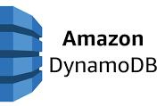
TDM and Data Reconciliation – GPAS data flow
Synthetic Test Data
2
Insight/UWWB
3
4
GW Integration gateway
5
Guidewire (PC/BC)
1
MDA
Reference Data
8
7
6
A
CDA
Test Data Creation :
Dynamic/generic test data using AI / Opensource tool
Static (reference) test data creation
Orchestration options:
A. Get/update/delete via API: Any system to make API call to get required test data
B. DB Connection
Test Data Generation tool – Generate synthetic data and publish on DynamoDB
Transform data from DynamoDB in required structure / format for ingestion in application
MDA consumes data processed in source system and enriches the data
Bind event / Submission published on Kafka topic for Guidewire (GW) integration gateway
Guidewire Policy Center consumes data from GW Integration gateway
Guidewire Bind success message sent to GW integration gateway
GW integration Gateway publish data on MDA
UWWB/Insight consume from MDA
Agresso workflow
A. GW integration to CDA replication
B. Fivetran to pull the data and send to Snowflake
C. Snowflake to Agresso
B
MDA-Snowflake
C
Agresso
Validation of the approach – Proof of concept
Created synthetic test data
Reference data setup (Org, Producer) – MDM, CRM
Used Playwright to structure the payload
Ingest data into Guidewire API
Bind and Issue > Billing Centre > CDA
Data successful loaded in Snowflake for finance

Slide 7
Test Data Management and Reconciliation – GPAS data flow
Key Principles
Data ingestion at source
Aligned to event driven arch.
ü
ü
Synthetic test data
ü
Automation
ü
Data integrity
ü
Reconciliation
Automated
Synthetic Test Data Creation
1
2
Insight/UWWB
3
4
GW Integration Gateway
5
Guidewire (PC / BC)
Amazon
DynamoDB or similar
MDA
Pre-Requisite
Reference Test Data
8
7
6
Orchestration options:
A. Get/update/delete via API: Any system to make API call to get required test data
B. DB Connection
Test Data Generation tool – Generate synthetic data and publish on DynamoDB
Transform data from DynamoDB in required structure / format for ingestion in application
MDA consumes data processed in source system and enriches the data
Bind event / Submission published on Kafka topic for Guidewire (GW) integration gateway
Guidewire Policy Center consumes data from GW Integration gateway
Guidewire Bind success message sent to GW integration gateway
GW integration Gateway publish data on MDA
UWWB/Insight consume from MDA
Agresso workflow
A. GW integration to CDA replication
B. Fivetran to pull the data and send to Snowflake
C. Snowflake to Agresso
CDA
MDA-Snowflake
Agresso
A
B
C
Validation of the approach – Proof of concept
Created synthetic test data
Reference data setup (Org, Producer) – MDM, CRM
Used Playwright to structure the payload
Ingest data into Guidewire API
Bind and Issue > Billing Centre > CDA
Data successful loaded in Snowflake for finance
Reconciliation
Confluent control center, Datadog, S3 bucket, Snowflake dashboard to reconcile record counts

Slide 8
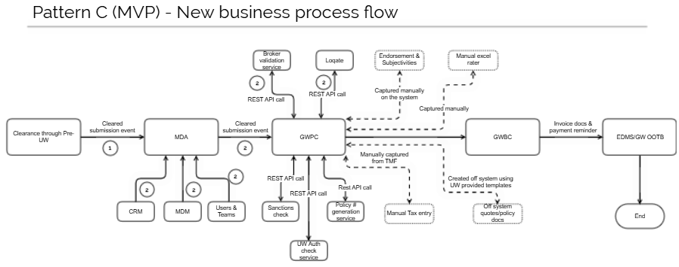
Process Flows – Pattern C

Slide 9
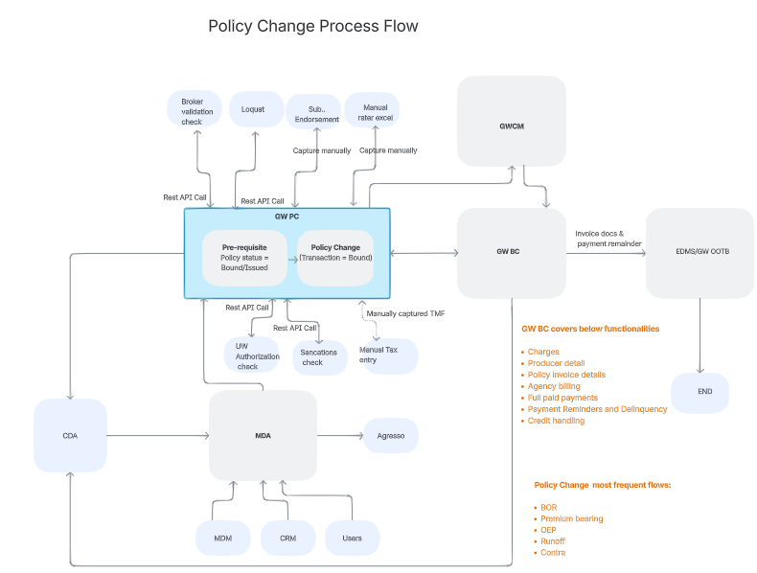
Process Flows – Pattern C

Slide 10
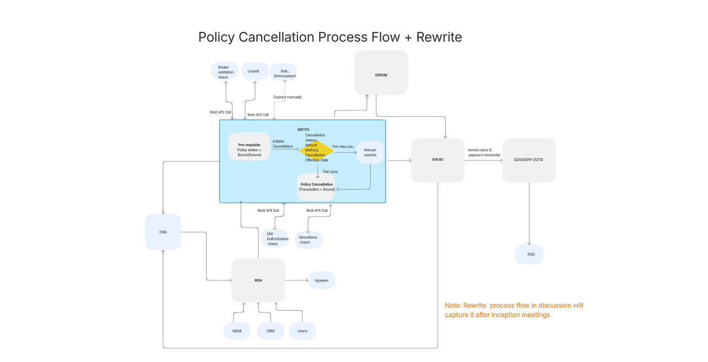
Process Flows – Pattern C

Slide 11
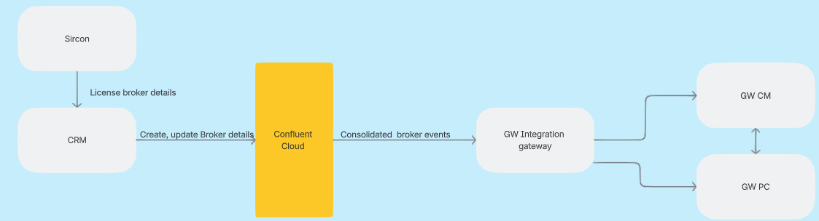
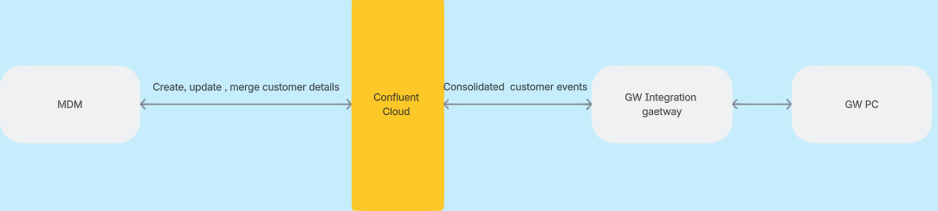
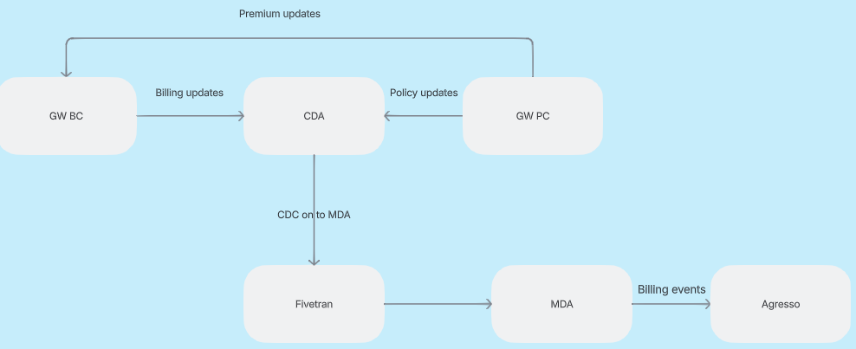
CIT
CRM Integration
MDM Integration
Agresso

Slide 12
Team capability - Empowering Excellence through continuous learning and upskilling
Focus Areas
Insurance Capability
Certifications
Guidewire Niseko (50%)
Agile certified
Automation certified
Insurance domain trainings
Level 1 and Level 2
Industry training and certification
Testing Trainings
Testing - ISTQB
Domain - P&C, Speciality lines
Platform - Guidewire
Soft skills
Leadership skills
Practice
Rewards and Recognitions
Sandbox URLs for practice
SMEs support
Assessing and recommending Tools and Accelerators from COEs
GenAI COE
Guidewire Connect
Dedicated test instance
Availability of SPOCs from Guidewire product team for technical support
SPOCs from Capgemini for constant support
Up to date information on new releases

Slide 13
Performance simplified tool
02

Slide 14



Performance Simplified
“Performance Simplified is Capgemini in-house web-based tooling solution built on JMeter to orchestrate performance executions leveraging automation and driving maximum efficiencies & future transformation”
Challenges with JMeter:
Dependency on user machine: The test must be triggered from the user's machine, which can be limiting.
Complex setup: Setting up the master/slave configuration for higher load execution is cumbersome.
Lack of real-time monitoring: There's no real-time monitoring available.
Poor test reporting: The test reporting is not up to the mark.
Tool freezes: JMeter tends to freeze during tests, often due to running out of memory.
Challenges with generating scripts that necessitate enabling the browser port.
Business Need
Key Features
Execution Platform
Analytics
Solution
Web Based Execution Platform
Upload Script – manually or via GIT
LG Setup –
On Premise & Cloud (On Demand)
Test Executions – Different Scenario Types
Realtime Test Monitoring
Save Results & Scenarios
Readily available Results
In Built Heap Memory Analysis
Trend & Comparative reports
Well-designed merged graphs with result summary download functionality
One Stop solution for performance execution & analysis.
Real time analytics. 10-15% effort reduction in execution & analysis efforts
Analytics features like heap dump or comparison/trend report with a single click.
20% infrastructure cost reduction (applicable for cloud LGs)
Cognitive
Script Design
Generate JMeter Scripts effortlessly. No requirement for port opening or additional configuration adjustments.
No need to setup tool or worry for tool infrastructure setup.
CI/CD integrations (need customization)
Benefits

Slide 15
Data reconciliation
03

Slide 16
Reconciliation Process
1
2
3
4
5
6
Insight/UWWB
MDA
GPAS
GPAS
MDA
Agresso
Insights- Data submission via API call/automation script
UWWB – Data should reflect in UWWB
MDA Private Cluster- Access restricted
MDA Public cluster Enriched data should reflect via cluster linking. Verify using confluent control center/python script
Guidewire Integration gateway consume data from MDA public cluster- Refer to the Datadog Dashboard
Guidewire PC/BC-
Refer to the Datadog Dashboard
CDA Verify records in AWS S3 bucket
Guidewire Integration gateway Refer to the Datadog Dashboard
Snowflake
Fivetran connector should pull data from CDA and send to Snowflake- Verify records in Snowflake dashboard
TBD
MDA Public cluster Guidewire processed data

Slide 17

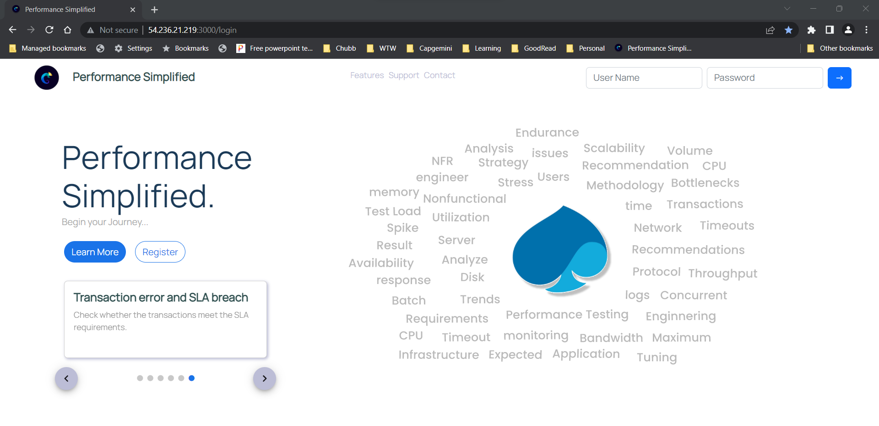
Demo
Back to Outside In Perspective Slide

Slide 18
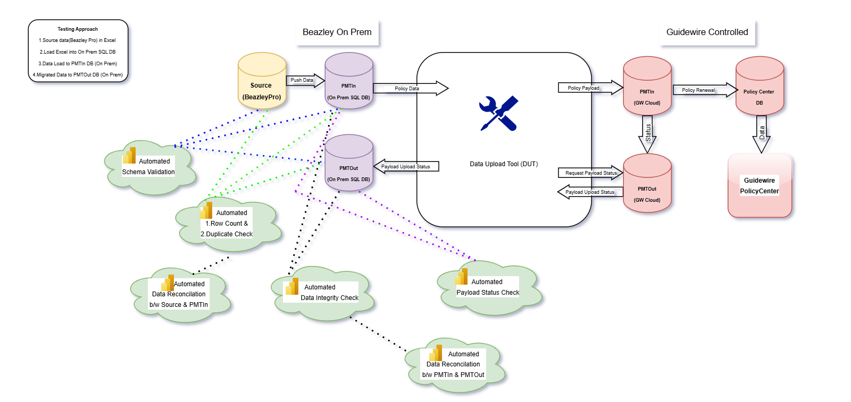
GPAS Data Migration

Slide 19


TESTING Framework
London Insurance Market Integration Testing

Slide 20
Key features of the Framework
Model based- Helps creation of test scripts in a modular way. This will ensure progressive testing of London Market integrated process stages incrementally, leading into e2e process validation.
Automation enabled- Process incorporated to Identify automatable candidates pertaining to London Market scenarios upfront to enable automation as a continuous process.
Market Standards aligned- Ensures that the applicable London Market processing guidelines (Quality) are adhered in testing. E.g. Feeds, Workflow , Data, Environment, Documents, Interoperability …
Assurance incorporated- Quality Standards, Process improvements, Value stream mapping, Metrices, Quality gates, signoffs, reports suited to organization specific ways of working
Reusable Artefacts- Assets which can be adapted for different implementations

Slide 21











London Insurance Market – E2E process stages
Customer Need, Risk Placement & Negotiation (Broker-> Syndicate, MGA/UW’s), Policy Issuance, Claims, Finance & Regulatory
UW Room
1
2
3
4
5A
5B
6
7A
9A
9B
9C
7B
Policy - Signing Messages:
Lloyd’s – USM (Linked, De-Linked & Settlement)
ILU - IPCCSM, ILUCSM, ILUCSB
9D
Bureau – Insurer Integration Layer
(FTP/EDI/API based Integration)
Claim-Signing Messages
Lloyd’s & ILU:ECF Write-Back (ECF Claim notify, Retrieve/Respond)
Lloyd’s/ ILU: SCM/LIMCLM (Claim Movement/Settlement)
10
9E
8
Claim Update & Retrieve
ECF - FNoL
……
11
12
13
14
15
16
Documents - IMR
Claim Movement
& Reserve
Claim Settlement (Partial/Full)
Finance & Credit
MI
Compliance & Regulatory
Key Process stages
1 – Customer Approach Broker
2 – Broker Create MRC/Slip
3 – Broker Presenting risk with Lead Ins
4 – Broker presenting risk with Follower
5A – Quote issued
7B– Bureau Signing message creation for policy
8 – Signed Premium, %, Schedule and Settlement process in PAS and downstream
9A - Claim Notified
9B – Claim negotiated
9C – Claim details captured in Bureau Xchanging system
9D– Bureau Signing message for Claim creation
10 – Claims update from Xchanging Bureau
11 – Documents update/search/download
12- Claim update with financial details
13 – Claim settlement
14 & 15 – Claims flow down to FI and MI
16 – Compliance Reporting
5B – Risk agreed by all parties and Policy Issued
6 – Risk data uploaded in Xchanging system
7A – Risk captured in Bureau Xchanging settlement Systems for signing message

Slide 22


Re-Usable Testing Artefacts by stages
7B
8
7B
7B
USM
UWRSET
IPUCSM
ILUCSB
UW/Policy related messaging Scenarios
Re-Usable predefined test pack to cover Lloyd’s
market transactions
Re-Usable predefined
test pack to cover Lloyds
market settlement
Re-Usable predefined test pack to cover ILU market signing transaction
100% Re-Usable predefined test scenarios to cover ILU market transactions
Carriers Testing with Market (Xchanging)
Covered signing De linked & Non-Delinked messages for New business, MTA and Renewal combinations
Covered signing messages for Premium, Additional, Refund transactions
Covered signing De linked & Non-Delinked messages for New business, MTA and Renewal combinations
Covered signing messages for Premium, Additional, Refund transactions
9E
11
13
13
ECFWB
DRI(IMR)
SCM
LIMCLM
Claim related messaging Scenario
Predefined test pack to cover Document
Management
Re-Usable predefined
test pack to cover
Both Lloyds & ILU
Test pack covers Claims settlement for Lloyds
Covers Claims reserve and settlement for ILU
Covered FNoL, Claim Retrieve and Response to-from Xchanging
Covered document search, retrieve, download and upload

